Slide 1
GLOBAL NEXT CONSULTING INDIA PRIVATE LIMITED
2039
MINI PROJECT REPORT
SUMMER INTERNSHIP PROGRAM IN AI & ML
TOPIC: Cyberattack Trends By Sector
Presented By: BETHA JAYANTH VEER
Date : 08-06-2026

Slide 2
PROJECT OVERVIEW
Project Title: Cyberattack Trends By Sector
Domain: Cybersecurity
Problem Statement: To analyze publicly reported cyber incidents across different sectors and identify trends, affected categories, locations, and financial losses using data analysis techniques.
Dataset Used: Kaggle Cybersecurity Incidents in India
Project Overview:
Analyze cyber incidents across industries.
Identify the most common attack types.
Find the most affected categories and cities.
Study year-wise trends in cyber incidents.
Evaluate the financial impact of cyberattacks.
Tools And Libraries: Python,Pandas,numpy, matplotlib and Jupyter Notebook

Slide 3
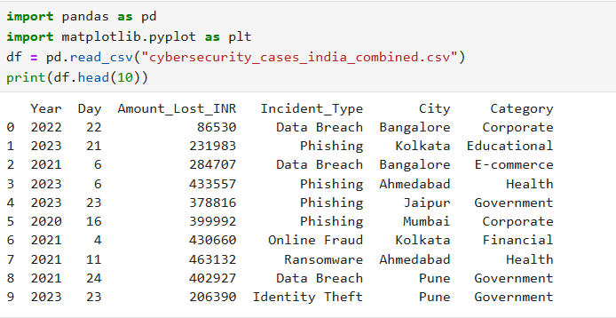
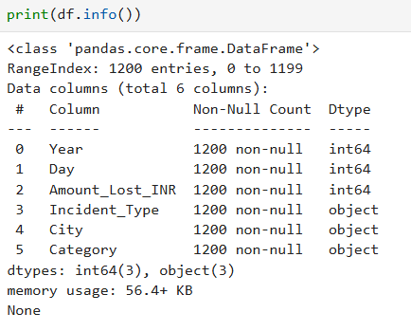
DATASET DESCRIPTION
The dataset contains publicly reported cybersecurity incidents in India. It includes details such as year, incident type, city, affected category, and financial loss. The dataset helps in understanding cyberattack patterns, affected sectors, and the economic impact of cybercrime.

Slide 4

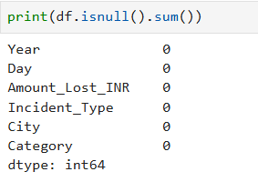
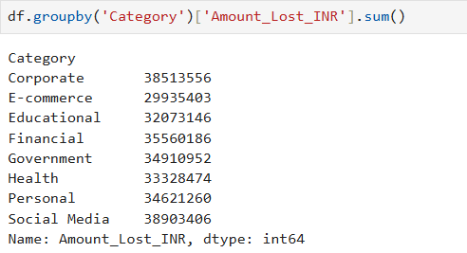
DATASET DESCRIPTION
We perform data preprocesing to prepare the datsset for analysis.. we check whether the data set contains null or duplicate values.

Slide 5
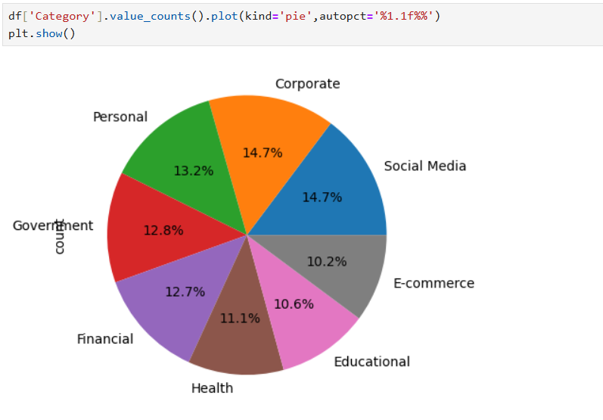
INCIDENTS BY CATEGORY
The dataset was analyzed to identify the categories most affected by cyberattacks .
Incident frequencies were calculated and visualized using bar charts.

Slide 6
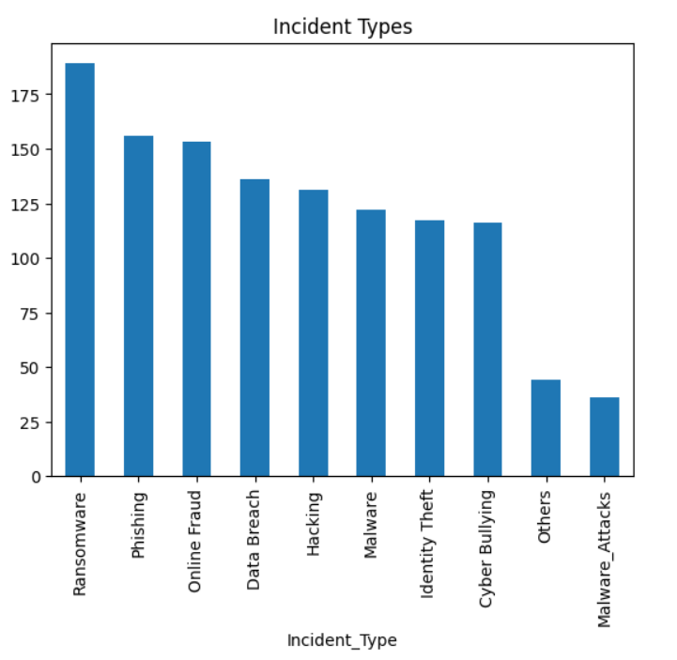

INCIDENTS BY INCIDENT TYPE
Different cyberattack types were analyzed to determine the most common threats .
Results were visualized for easy comparison .

Slide 7
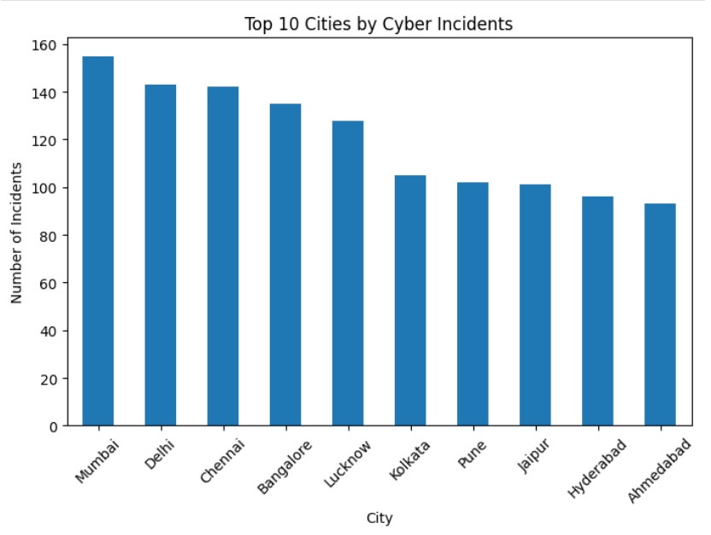
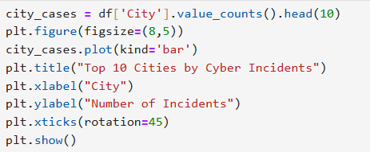
INCIDENTS BY CITY WISE
Cyber incidents were analyzed across cities.
The most affected cities were identified.

Slide 8
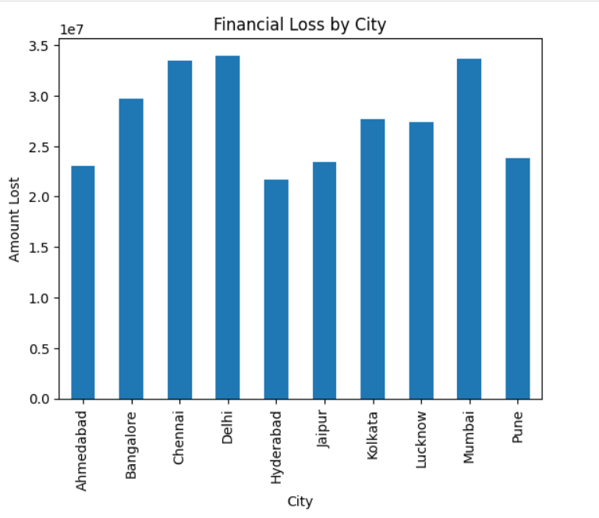
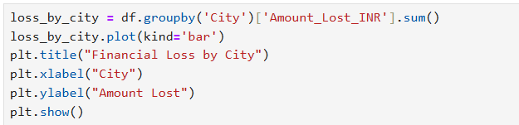
FINANCIAL LOSS ANALYSIS
Financial losses caused by cyber incidents were calculated.
Category wise loss distribution was examined.

Slide 9
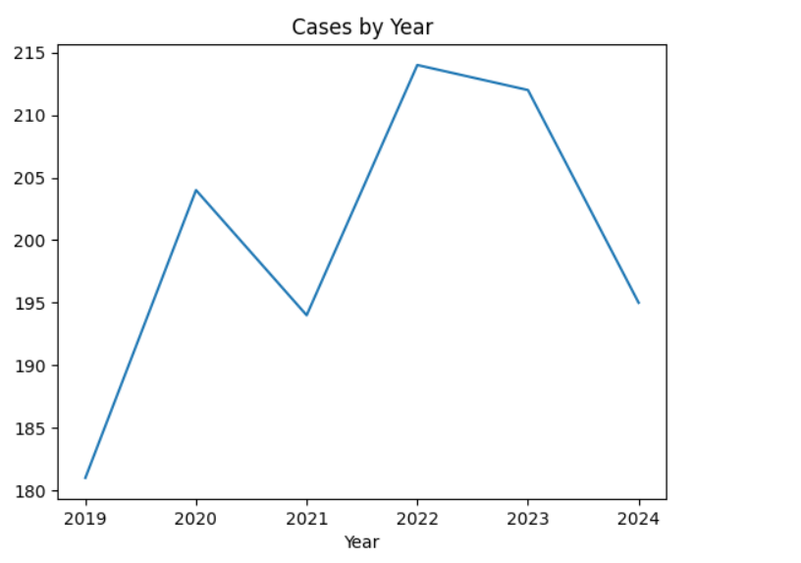

YEAR-WISE TREND ANALYSIS
Cyber incidents were analyzed across different years.
Trends were visualized using line charts.

Slide 10
CONCLUSION
In this project, I analyzed a cybersecurity dataset to understand the trends and impact of cyber incidents. The data was cleaned and examined using Python and different visualizations were created to identify important patterns.
The analysis helped in understanding the most common types of cyber incidents, the cities and categories most affected, and the financial losses caused by these attacks. The results show how data analysis can be used to gain useful insights into real world cybersecurity problems.

Slide 11
THANK YOU

